Slide 1
Direction
ELECTROMAGNETIC
ELECTROMAGNETIC
FIELD
FIELD
DAT505 – Creative Coding
Generative art
Ethan Bull

Slide 2
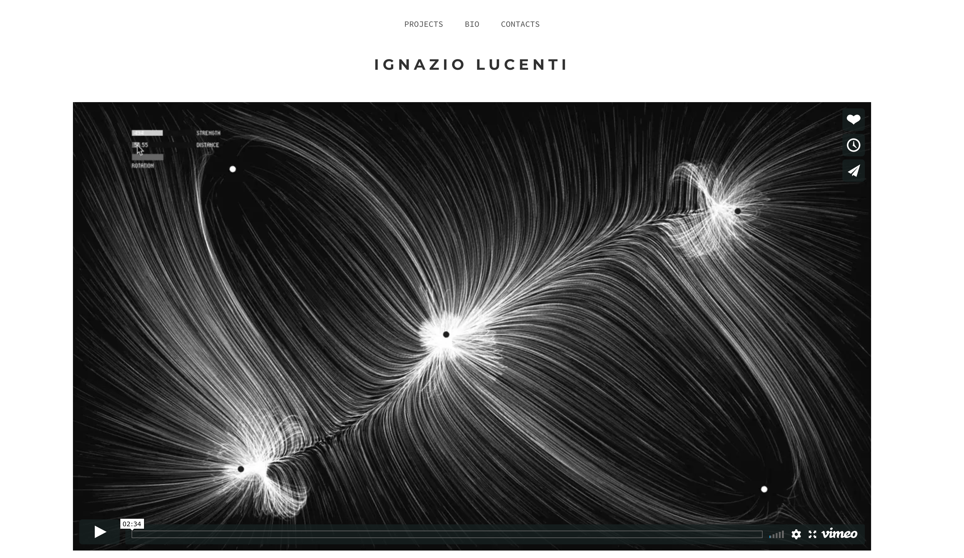
Inspiration
https://www.ignaziolucenti.it/portfolio/magnetic-field/
DAT505 – Creative Coding
Generative art
Ethan Bull

Slide 3
Outcome
DAT505 – Creative Coding
Generative art
Ethan Bull

